Slide 1

Physical Layer Informed Adaptive Video Streaming Over LTE
Xiufeng Xie, Xinyu Zhang
Swarun Kumar
Li Erran Li
Unviersity of Winscosin-Madison
MIT
Bell Labs

Slide 2



Background
Video streaming: 70% of the mobile Internet traffic
Video streaming over LTE
10x speed over 3G
Only 20% quality improvement!
Stalling time: 7.5s to 12.3s for every 60s video
Notes:
Existing video streaming applications severely underutilize the LTE bandwidth

Slide 3




Challenges for video streaming over LTE

Slide 4

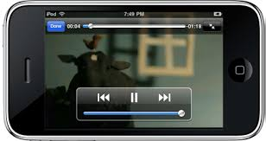
Challenge 1: Network bandwidth underutilization
  Problem description
LTE basestation
I thought LTE should be faster than this…
Video server
video
bitrate
network
bandwidth
Client
<<
Notes:
Existing video streaming applications severely underutilize the LTE bandwidth

Slide 5
Could DASH solve this bandwidth underutilization?
  What is DASH? (Dynamic Adaptive Streaming over HTTP)
Adapt the video bitrate based on the reported bandwidth
Measure downlink bandwidth
Feedback the bandwidth to the video server
Notes:
Dynamic Adaptive Streaming over HTTP or DASH is a promising streaming technique, could it solve the bandwidth underutilization problem?
Introduce what is the DASH:
The UE measures the downlink bandwidth
UE feedbacks the bandwidth to the video server
The server adapt the video bitrate based on the reported bandwidth

Slide 6
Could DASH solve the bandwidth underutilization?
  Conventional DASH may fall into a vicious cycle
OK, I should not increase the sending rate
I do not see any difference
Bandwidth increase
Report the same throughput
Notes:
In LTE networks, the throughput may largely underestimate the network bandwidth unless a video segment can saturate the client's end-to-end bandwidth
Existing DASH mechanism may fall into a vicious cycle

Slide 7
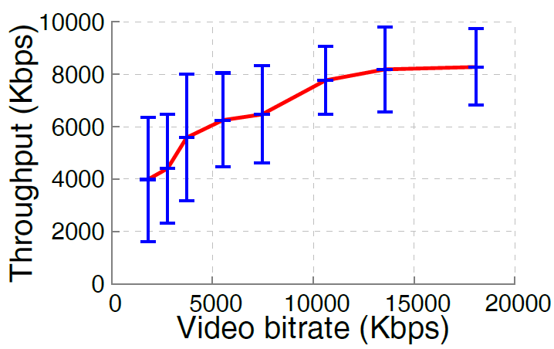
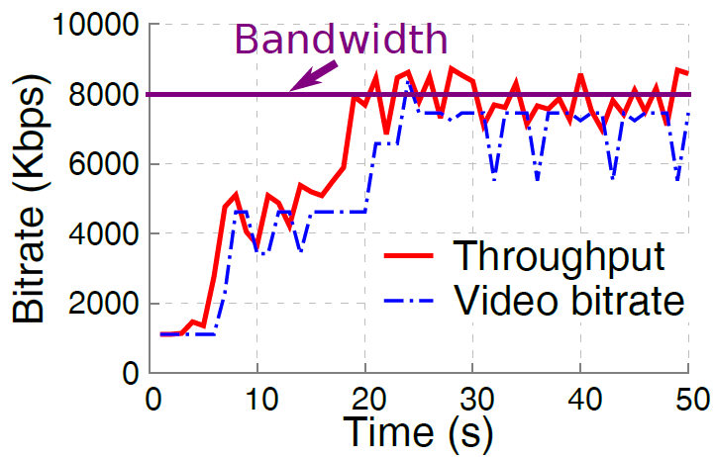
Vicious cycle in DASH
  Motivational measurements over LTE networks
Low video bitrate
Low throughput
DASH
Slow convergence to the network bandwidth
Notes:
We did some motivational measurements to validate the vicious cycle
We found lower video bitrate will lead to lower throughput (Fig 1)
The low throughput will in turn cause low video bitrate in DASH, which result in a very slow convergence to the bandwidth (Fig 2)

Slide 8
Challenge 2: Highly dynamic network bandwidth
  Problem description
Bandwidth is changing too fast, cannot adapt!
Bandwidth
Notes:
The highly dynamic network bandwidth of LTE network is another challenge

Slide 9
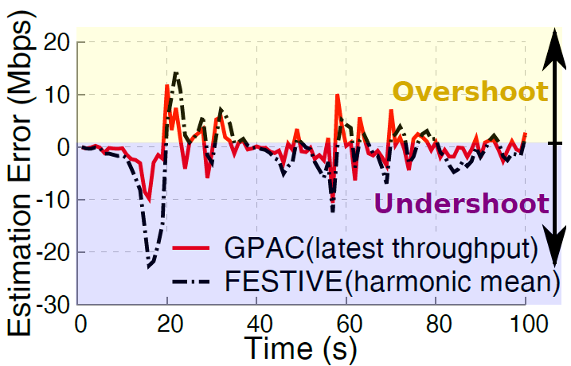
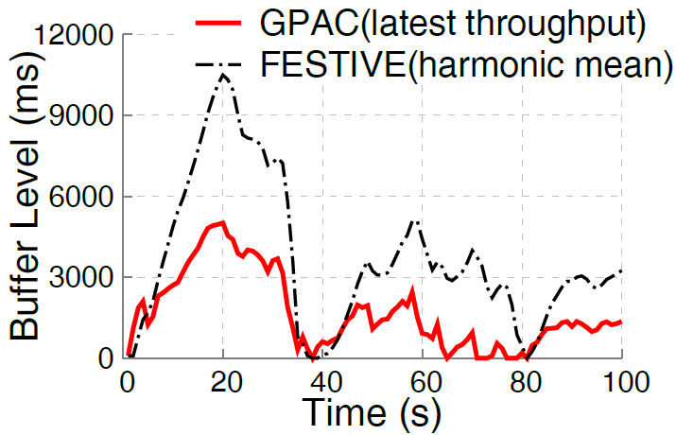
Challenge2: Highly dynamic network bandwidth
  Motivational Measurements over LTE networks
Existing DASH fail follow
the bandwidth variation
Poor adaptation drains
out client's buffer and
causes video stalls
Notes:
We also did some motivational measurements for that
1.Existing DASH algorithms cannot follow the bandwidth variation in LTE networks, causing either overshoot or undershoot (Fig 1)
2.The poor adaptation drains out client's buffer and causes video stalls (Fig 2)

Slide 10
Our solution: piStream

Slide 11
Architecture overview
  3 main components
LRD-based Video adaptation (LVA)
Radio Resource Monitor (RMon)
PHY-informed Rate Scaling (piRS)
Notes:
3 Components:
UE: Radio resource monitor
Server: PHY-informed Rate Scaling (piRS)
Server: LRD-based Video adaptation (LVA)
No modification to the eNB
Easy to deploy: firmware upgrade is enough

Slide 12

Basic workflow
  Monitor radio resource utilization to guide video adaptation
RMon:
50% radio resource
occupied
piRS: double the video bitrate
Principle1:
LTE network bandwidth utilization $≈$ radio resource utilization
Notes:
Work flow:
UE senses 50% PRB utilization
UE reports this value
Server double the video bitrate

Slide 13

Basic workflow
  Monitor radio resource utilization to guide video adaptation
RMon:
100% radio resource
occupied
piRS: we have converged to the bandwidth
Success
Solving the bandwidth underutilization
Notes:
Work flow:
UE senses 100% PRB utilization then
UE reports this value
Server knowns that we have converged to the bandwidth

Slide 14
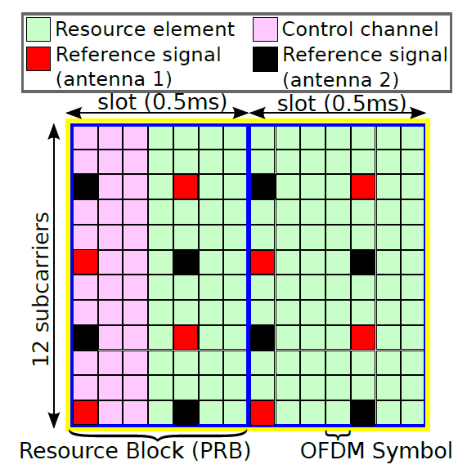
Design 1: Radio Resource Monitor (RMon)
  Why we can do this for LTE?
Radio resources are divided into resource blocks in LTE
The same MCS is used for all resource blocks allocated to the same user in one transmission
More resource allocated to a user, higher downlink bandwidth
Notes:
The unique LTE resource source makes it possible to estimate the network bandwidth utilization based on the radio resource utilization

Slide 15
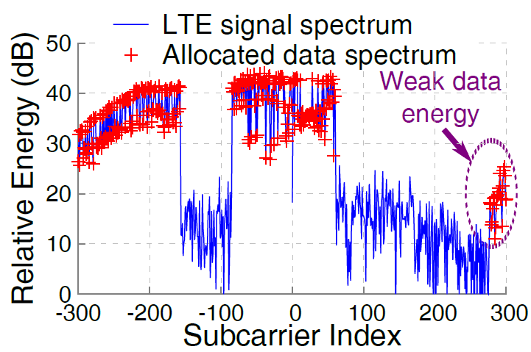
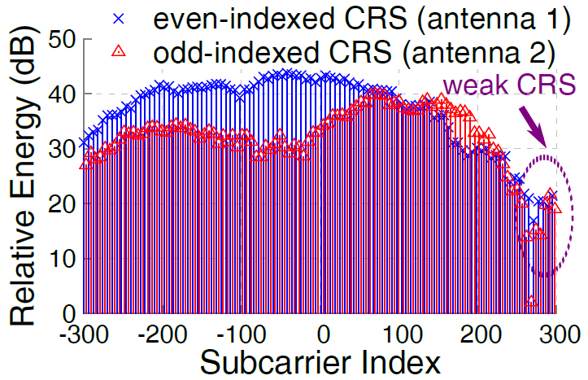
Design 1: Radio Resource Monitor (RMon)
  How to estimate the resource utilization?
Using an energy threshold?
Frequency diversity causes the problem
LTE reference signal captures the frequency diversity
Use the closet reference signal energy as the threshold of each resource element
Notes:
How to determine the energy threshold
Show the challenge of frequency diversity (Fig 1)
Solution: using reference signal as the threshold (Fig. 2)

Slide 16
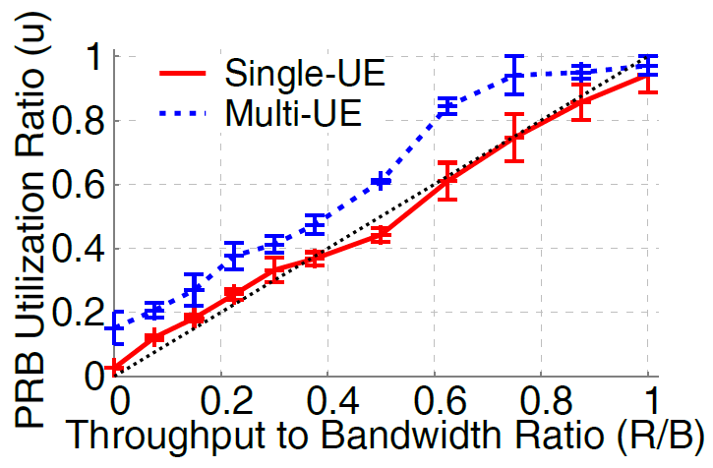
Design 2: PHY-informed rate scaling (PIRS)
  Resource utilization versus bandwidth utilization
Resource utilization ratio is almost proportional to the bandwidth utilization ratio
For a single UE, the relation is close to y=x
For multiple UEs, a close to linear relation still holds
Notes:
PIRS
The resource utilization is almost proportional to the bandwidth utilization

Slide 17
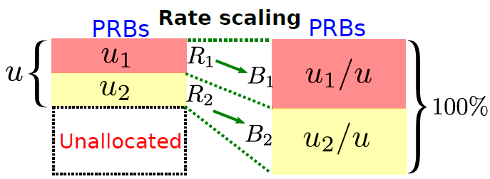
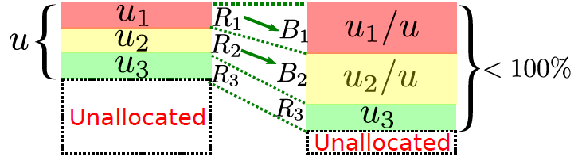

Design 2: PHY-informed rate scaling (PIRS)
  How to adapt video bitrate without overshooting bandwidth?
BB
$$B=R/u$$
Bandwidth = Throughput / Utilization
Only piStream users:
  The rates after scaling take up all the unallocated resources
Coexisting with legacy users (u3):
  The rates of the legacy user will not be scaled up
  Will not overshoot the bandwidth
Notes:
Use the rate scaling equation: bandwidth=throughput/utilization
Case1: only piStream users, we can take up all the unallocated resources
Case2: coexisting with legacy users, the rate of legacy user will not scale up, so we will not overshoot

Slide 18
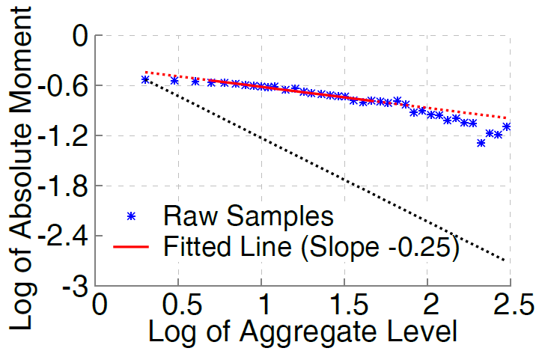
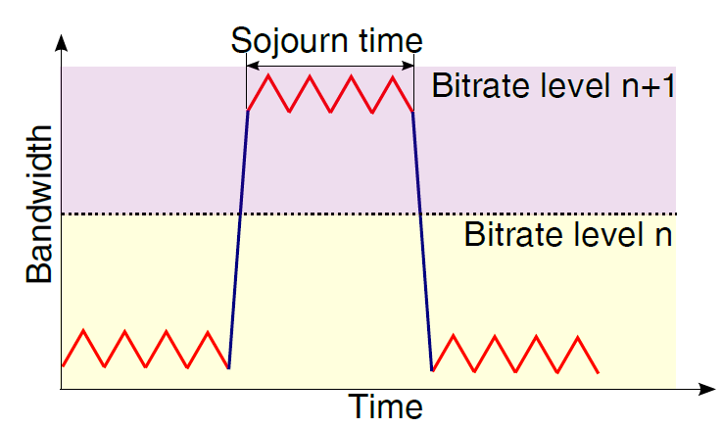
Design 3: LRD-based video adaptation (LVA)
  It is difficult to predict future bandwidth, we do not have to
Leverage the long range dependency of LTE traffic (A Hurst parameter 1-0.25=0.75 indicates LRD feature)
We can estimate how likely current bandwidth will hold for the next video segment

Slide 19
Design 3: LRD-based video adaptation (LVA)
  Estimate how likely current bandwidth will last
Bandwidth
Video bitrate
Historical value based adaptation:
  Adaptation is one segment behind the bandwidth variation in DASH
  Suffer from both overshooting and under utilization
bitrate
t
Small P
LVA: Follow the bandwidth variation with the sojourn probability P
  Do not follow the bandwidth variation when it is highly likely to be temporary
  If the bandwidth can hold for a longer duration, it is more likely to last for the next video segment (larger P)
bitrate
P1
<P2
<P3
t
bitrate
t

Slide 20
piStream Evaluation

Slide 21
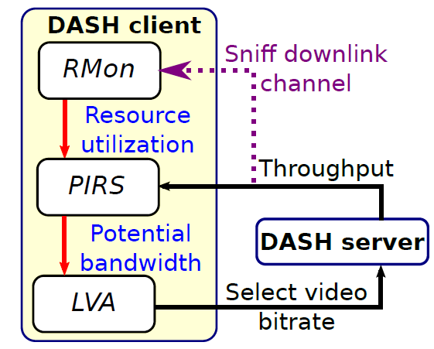
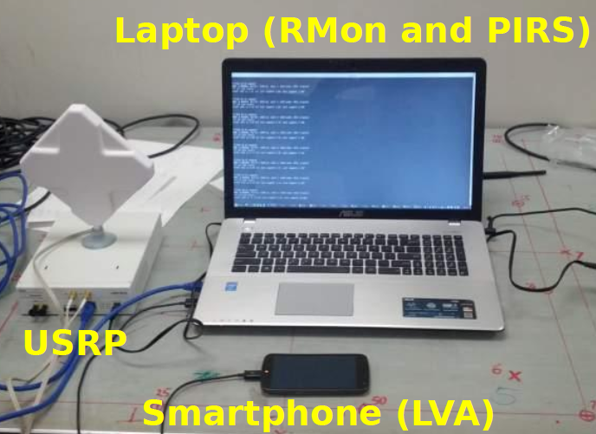
Testbed implementation
Notes:
We have implemented the 3 design components
Rmon, PIRS and LVA
The real implementation is shown in the photo

Slide 22
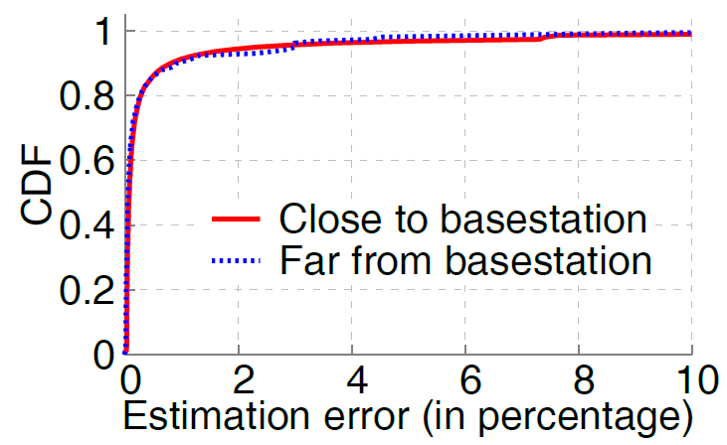
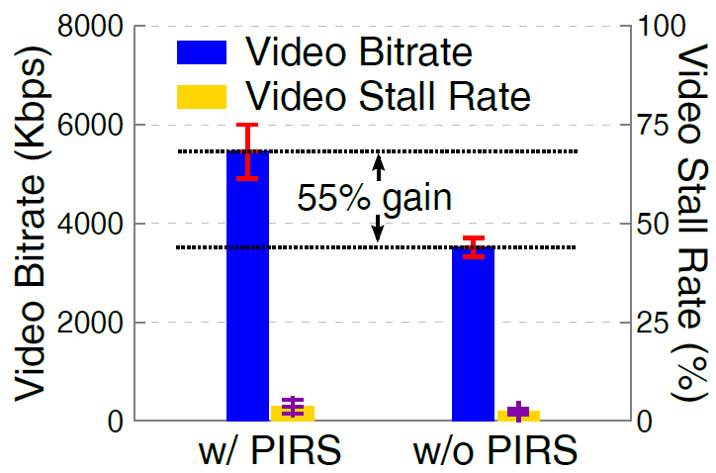
Micro benchmark (i)
RMon accuracy
  resource utilization vs bandwidth utilization
PIRS performance gain
  PIRS vs throughput-based DASH
  Our resource monitor outputs accurate resource utilization (error<10%)
  PIRS component alone improves the video bitrate by 55%

Slide 23
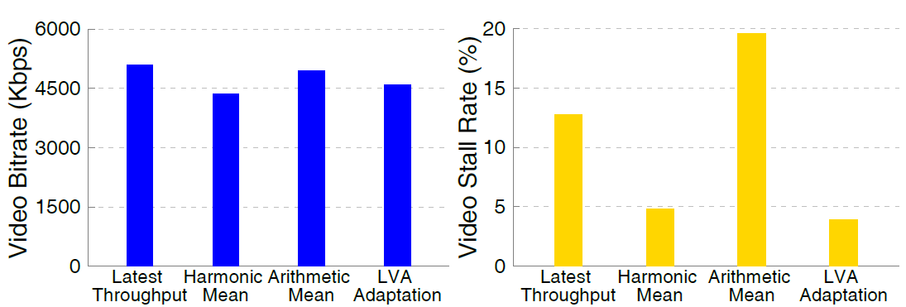
Micro benchmark (ii)
LVA video quality (bitrate) & smoothness (stalling rate)
  Compare with historical statistics based adaptation algorithms
  LVA significantly reduces video stalling rate at the cost of slight video bitrate drop
Notes:
Need to introduce the 3 different algorithms which leverage the historical statistics
1.Latest throughput
2.Harmonic mean of the historical throughput
3.Arithmetic mean of the historical throughput

Slide 24
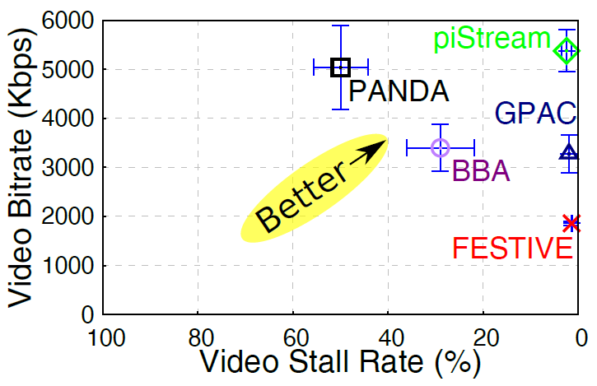
Comparison with state-of-the-art DASH algorithms (i)
  Static user
Benchmark algorithms
FESTIVE: adaptation based on harmonic mean of historical throughput
PANDA: probe the bandwidth until observing a throughput decrease
BBA: adaptation only based on buffer level
GPAC: adaptation based on last throughput value
  piStream outperforms other DASH algorithms
  1.6X video quality (bitrate) gain over the BBA and GPAC while maintaining a low video stalling rate close to 0%
Notes:
Need to introduce the benchmarks

Slide 25
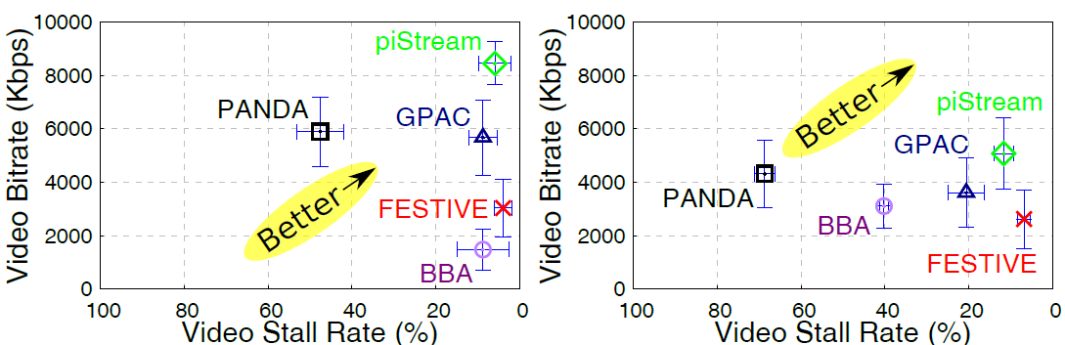
Comparison with state-of-the-art DASH algorithms (ii)
  With user mobility
Slow driving
Fast driving
  piStream maintains the highest video quality among all tested algorithms and a low video stalling rate
  Our spectrum monitor can report accurate PRB utilization ratio in mobility cases

Slide 26
Thank you!
Questions?

